Slide 1

Avila Bible
Analysis & Modeling
Notes:
Yacine

Slide 2

Dataset and context
12th century bible
12 copyists
Made in Italy and Spain (Avila)
Sample of 800 images split into 20000 patterns
Notes:
Yacine

Slide 3

Problem description
Inputs
Outputs
Pre-processed dataset:
Z-normalized
No missing values
12 Classes, identifying each copyists
A, B, C, D, E, F, G, H, I, W, X, Y
10 features describing writing patterns:
intercolumnar distance, upper and lower margins, etc…
Classifier model
Predictions
Metrics (Accuracy, MSE)
Notes:
Gab

Slide 4
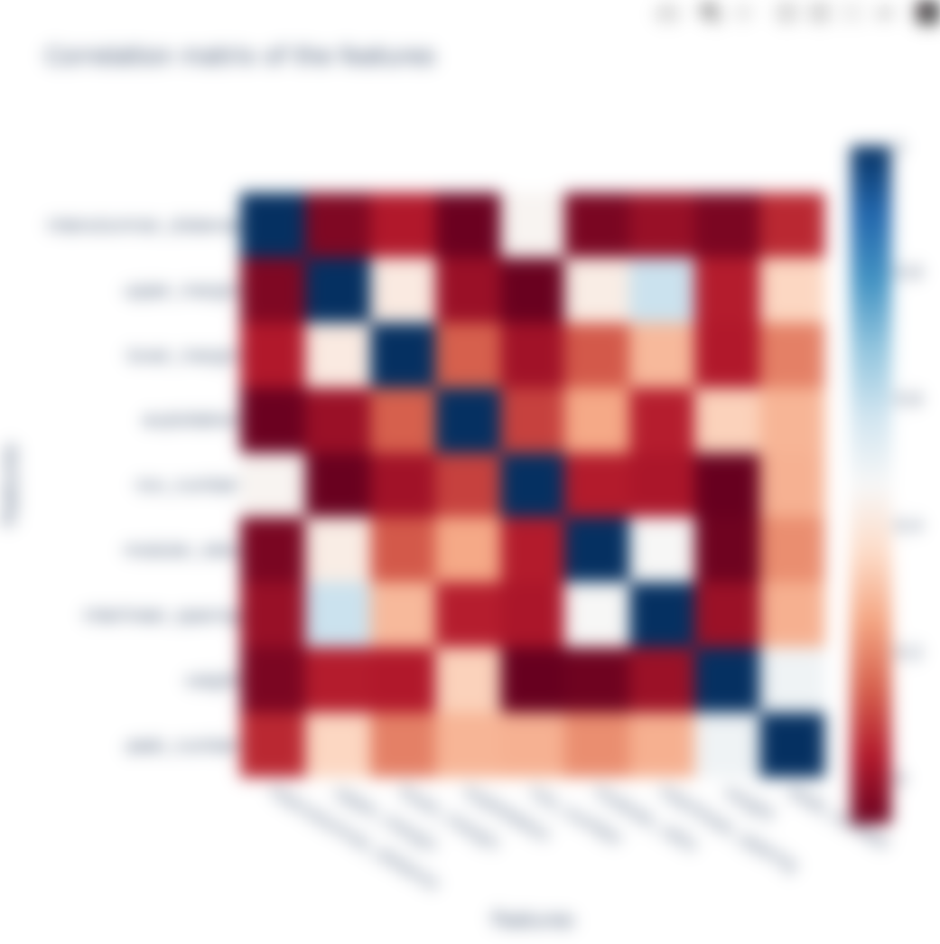
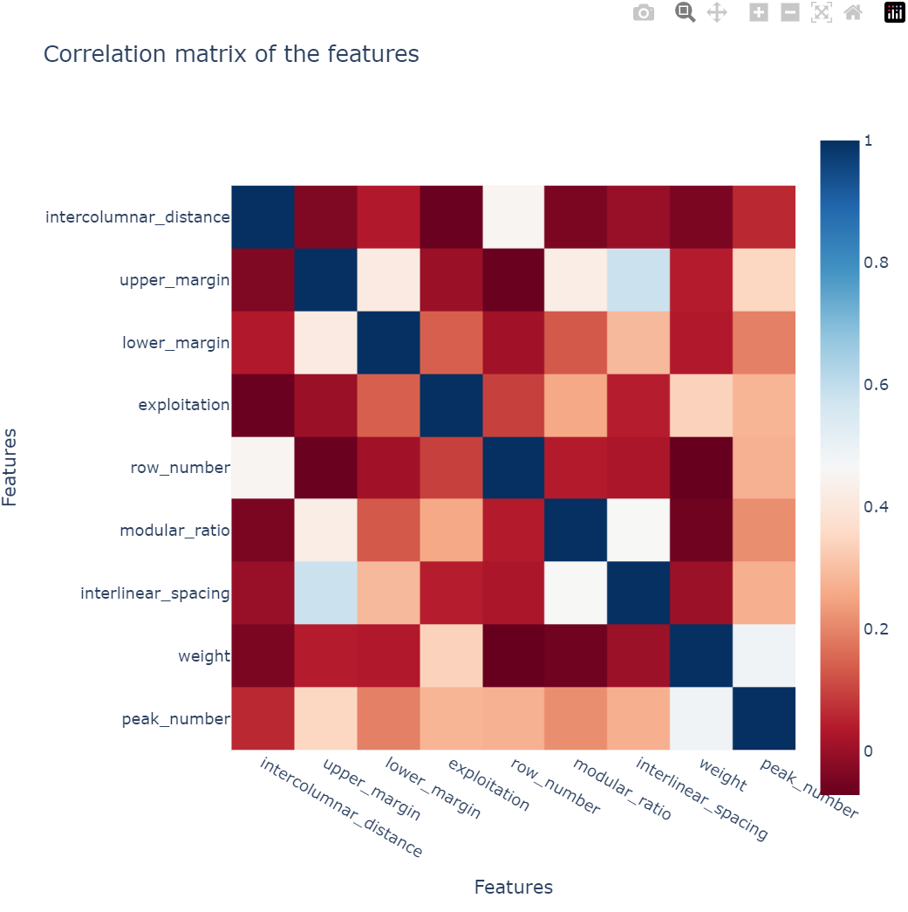
Data visualization
Notes:
Lisa

Slide 5
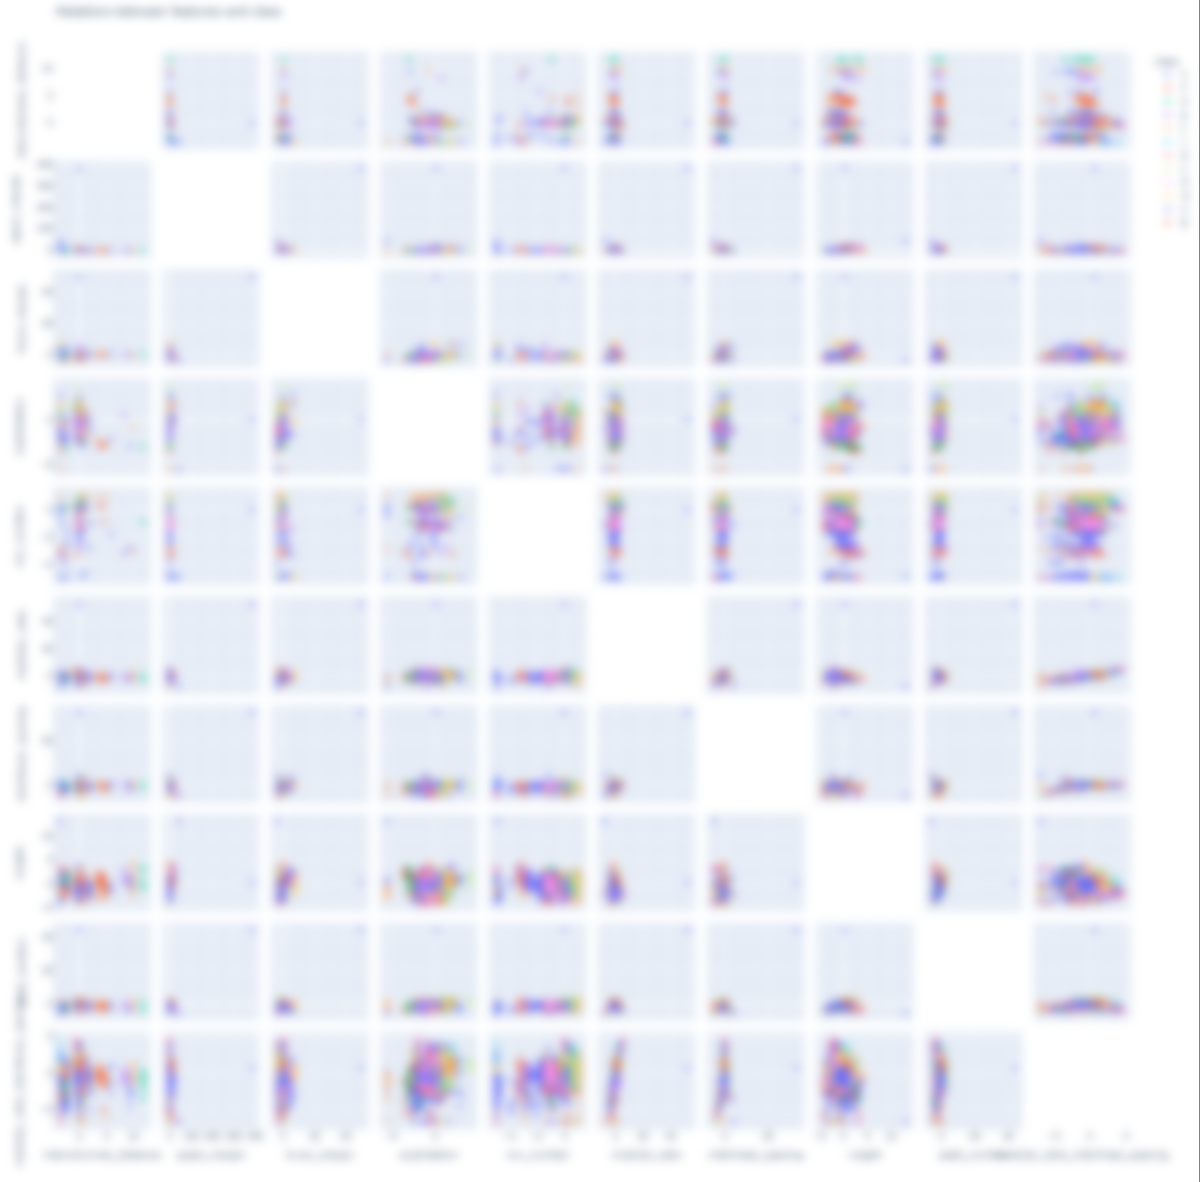
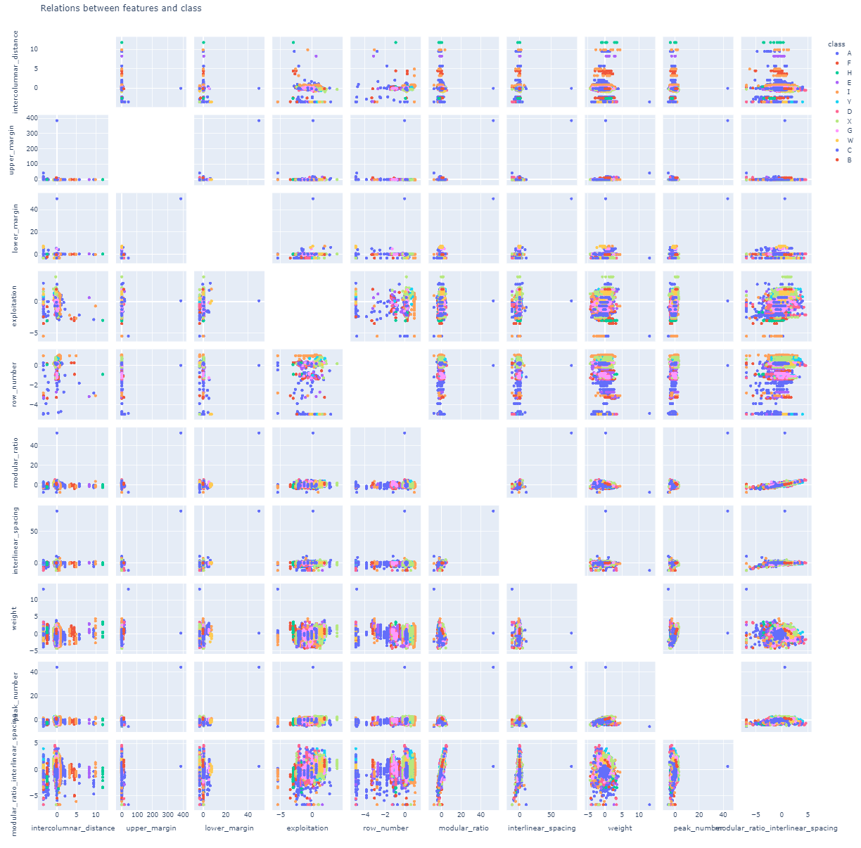
Data visualization
Notes:
Lisa

Slide 6

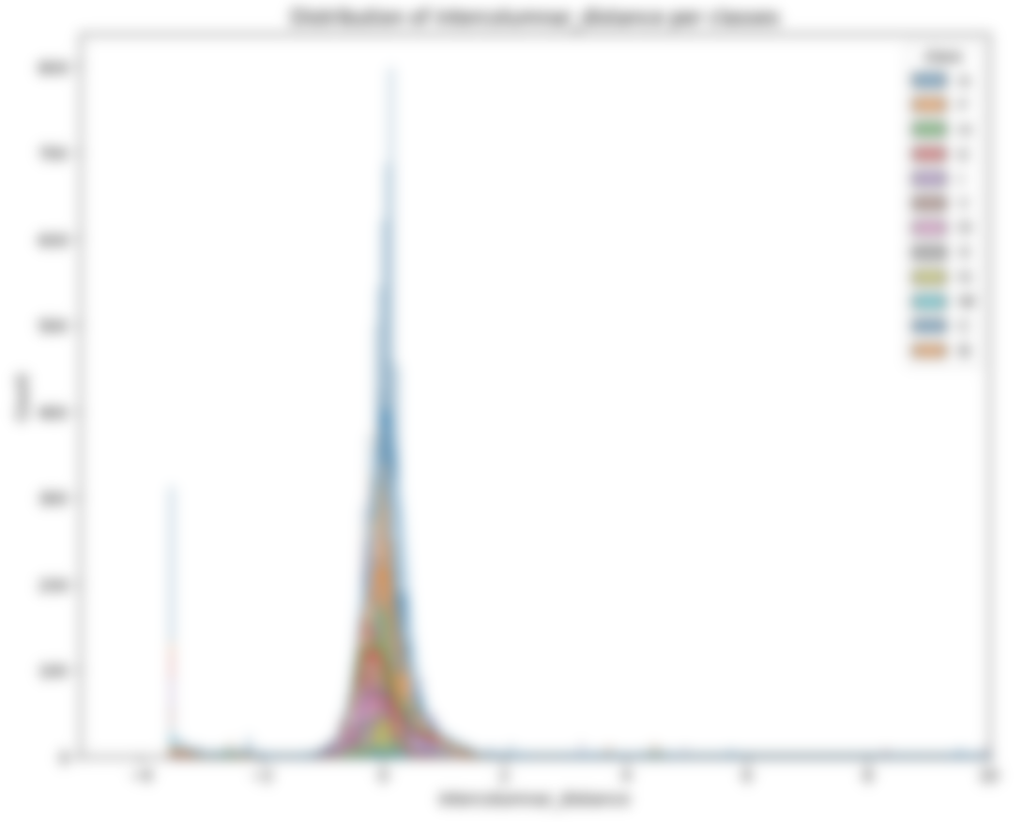
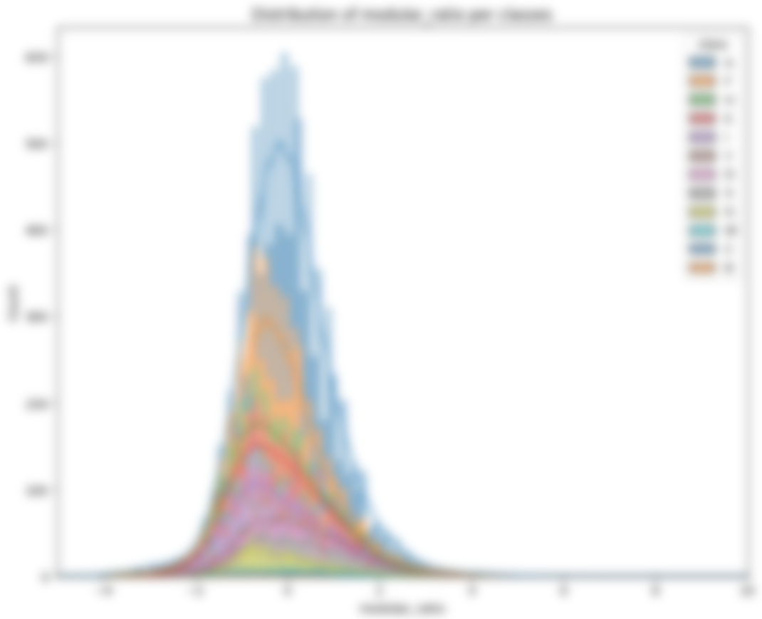
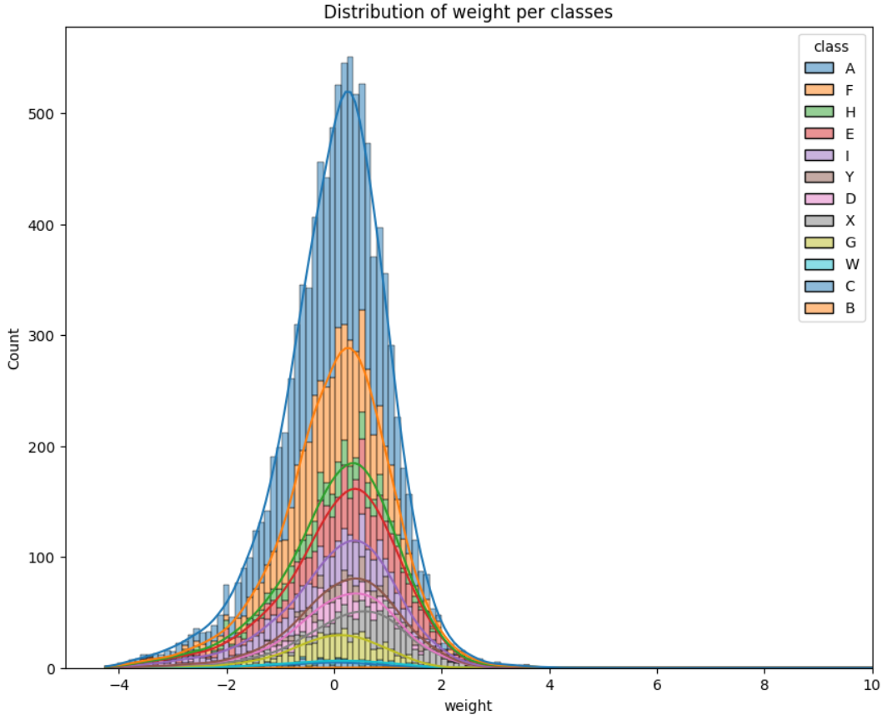
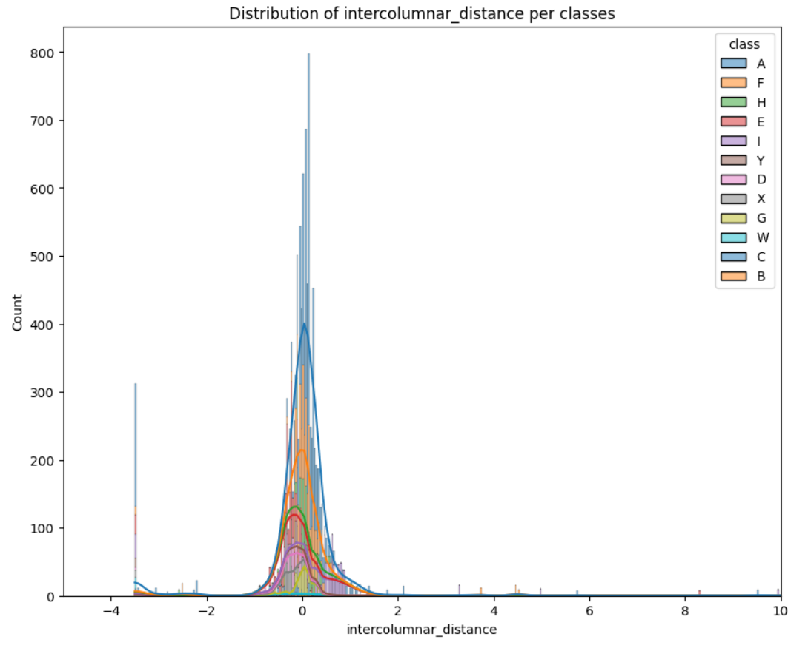
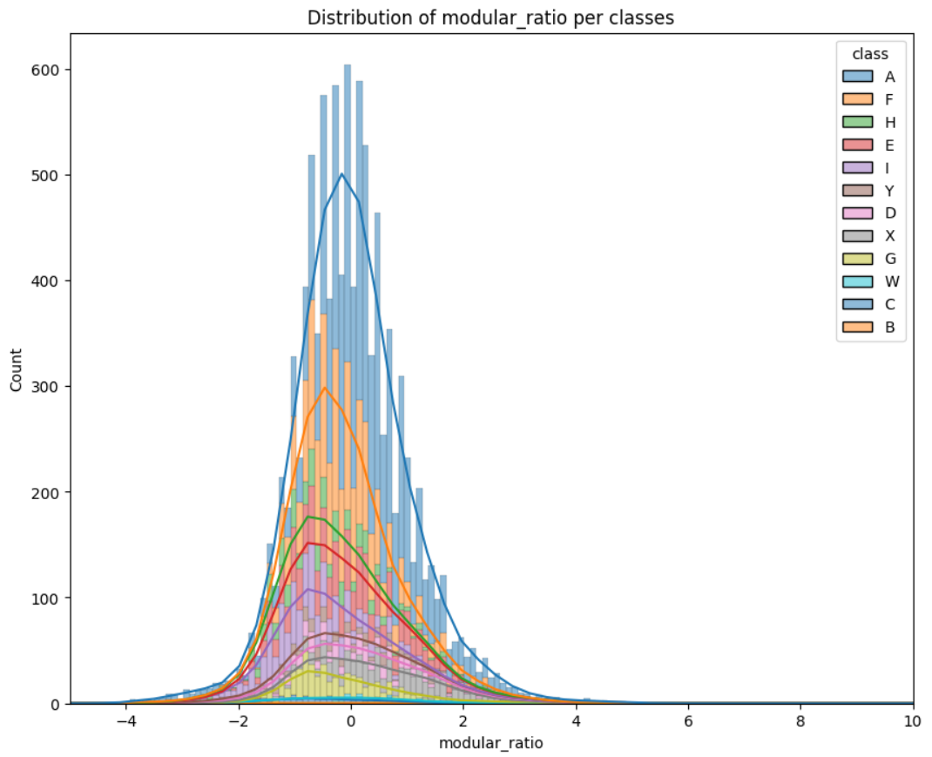
Data visualization
Notes:
Lisa

Slide 7
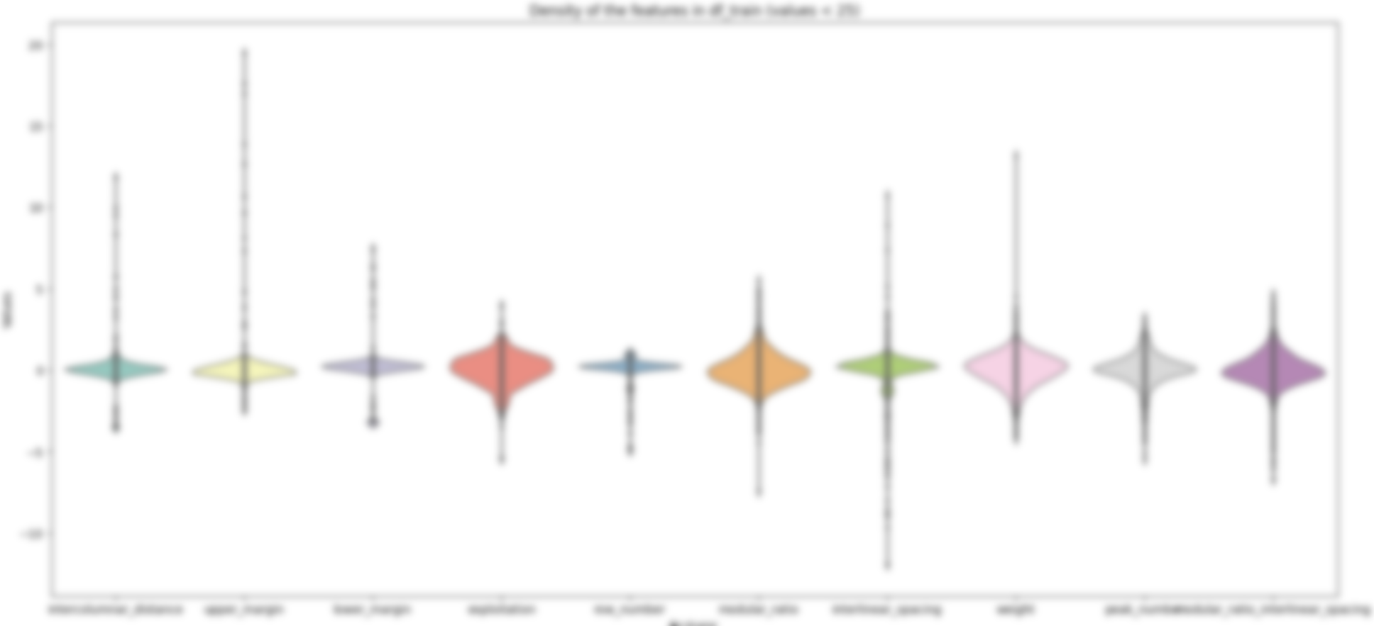
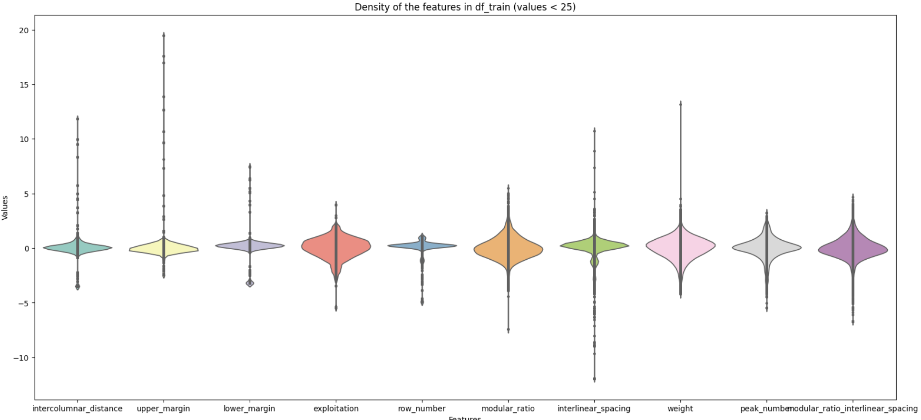
Data visualization
Notes:
Lisa

Slide 8
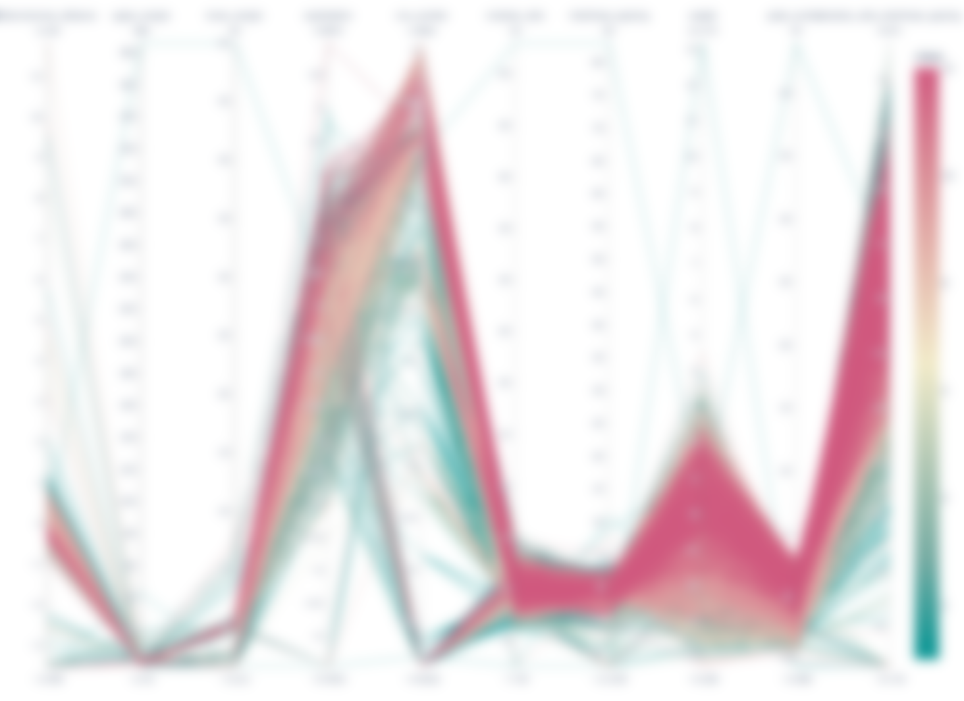
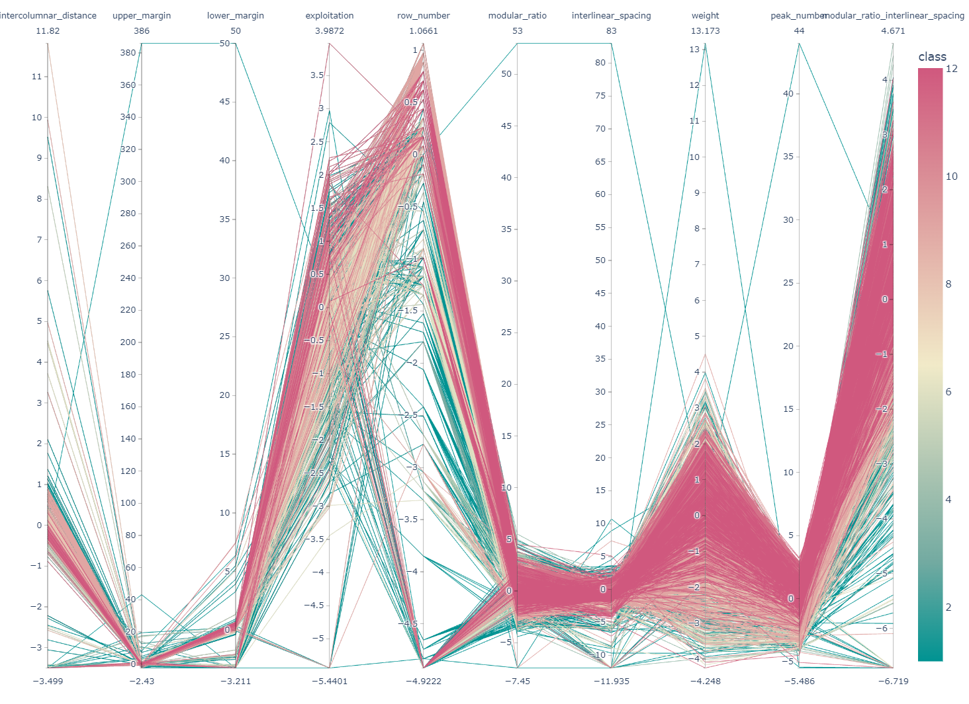
Data visualization
Notes:
Lisa

Slide 9
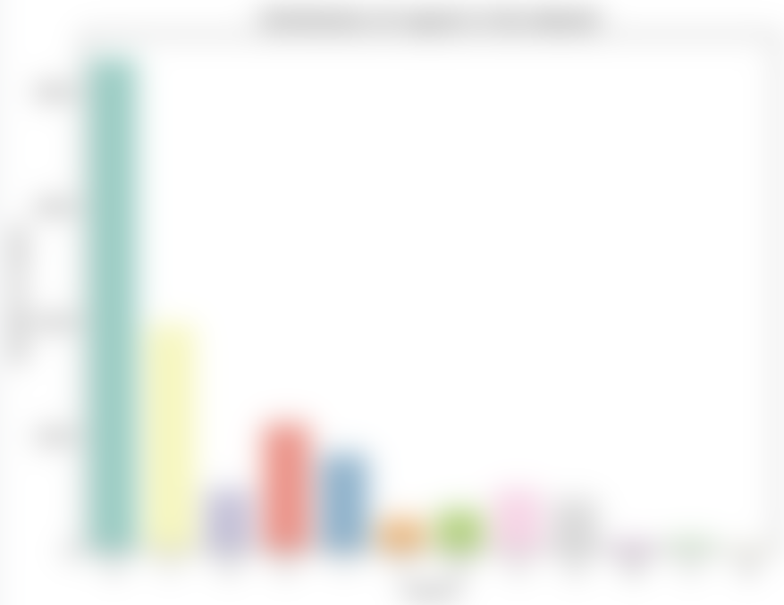
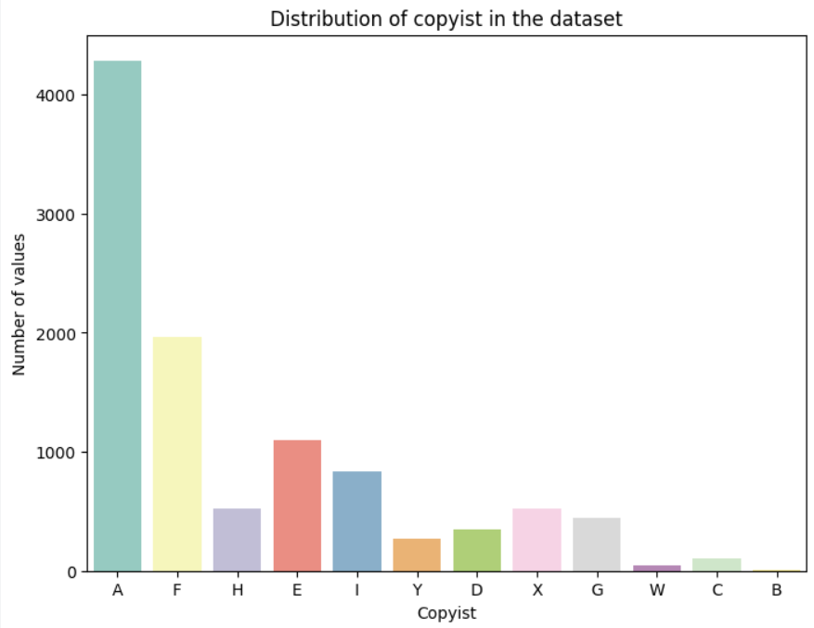
Data visualization
Notes:
Lisa

Slide 10

Model
Model ranking :
RandomForestClassifier - MSE : 0.467
DecisionTreeClassifier - MSE : 0.744
GradientBoostingClassifier - MSE : 1.124
MLPClassifier - MSE : 4.671
KNeighborsClassifier - MSE : 5.897
SVC - MSE : 7.888
LogisticRegression - MSE : 10.972
LinearDiscriminantAnalysis - MSE : 13.759
GaussianNB - MSE : 17.253
AdaBoostClassifier - MSE : 19.242
Notes:
Gab

Slide 11
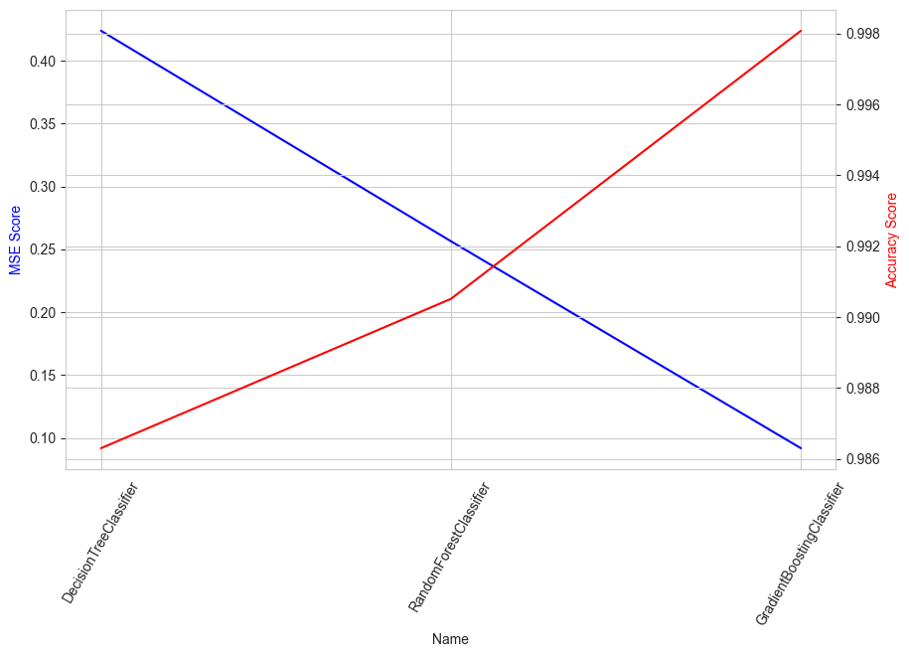
Model ranking after GridSearch :
GradientBoostingClassifier - MSE : 0.092
RandomForestClassifier - MSE : 0.279
DecisionTreeClassifier - MSE : 0.419
Notes:
Gab

Slide 12
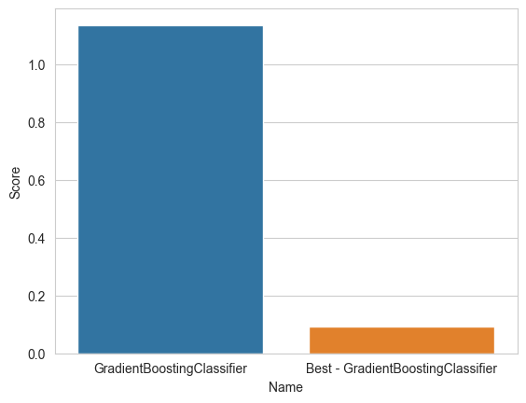
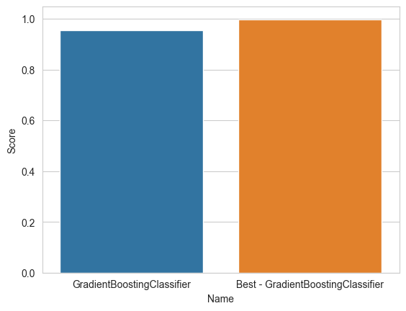
Model Enhanced with GridSearch
Notes:
Gab

Slide 13


Streamlit interface
Problem presentation
Dataset features visualization
Hyperparameters selection
Model metrics
Notes:
Yacine

